Slide 1
Expanding Numerical Reasoning Capabilities with ModernBERT and
Flan-T5
Aman Kumar and Deric Liang

Slide 2
01
Introduction

Slide 3
Overview and contributions
SemEval 2024 Task 7 - NumEval; Numerical Reasoning with Headlines
Overview
Objectives
Using numeral-heavy news articles to develop understanding of numeric semantics
Predict the missing number from the corresponding news headline
“Stealing $10” versus “Stealing $100,000”
Evaluate the performance of low-resource approaches with fine-tuning relative to the existing literature
Expand beyond the accuracy evaluation of the Numerical Reasoning task and demonstrate how additional metrics can provide additional insight
Contributions
Models
Showcase how models released after SemEval 2024 perform
Demonstrate performance of low-resource approaches compared to previous literature
Demonstrate power of relatively little fine-tuning on model performance
ModernBERT
Flan-T5
Notes:
Derived from one of the SemEval challenges Tasks from 2024. Headline prediction task where a news article was provided.

Slide 4
02
Methods

Slide 5
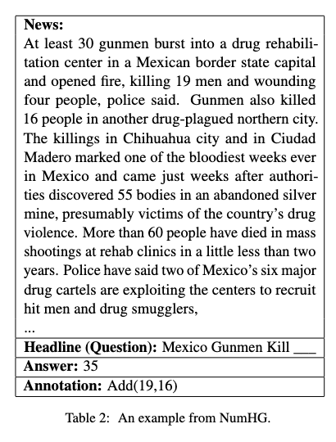
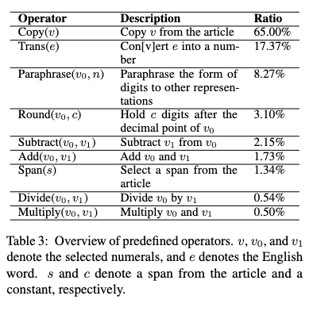
Data

Slide 6
Modeling
Train on multiple dimensions:
Mixed Training Set
Reasoning Training Set
Base ModernBERT (150M) and Flan-T5 (248M) models
Versions:
Baseline
Mixed Reasoning
Reasoning-only
Mix of PEFT (LoRA) and non-PEFT

Slide 7
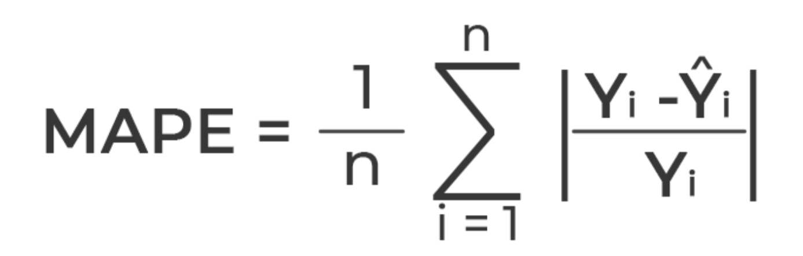

Metrics
Accuracy
Mean Absolute Percentage Error (MAPE)
Symmetrical Mean Absolute Percentage Error (SMAPE)

Slide 8
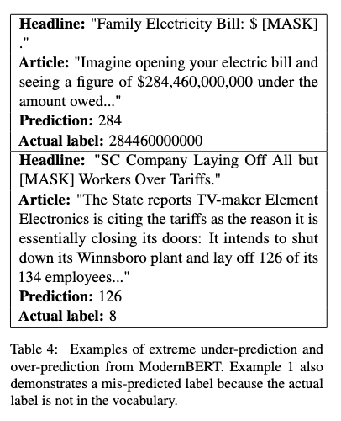
Note on metrics
Example 1:
MAPE = 100%
SMAPE = 200%
Example 2:
MAPE = 1475%
SMAPE = 176%

Slide 9
03
Results

Slide 10
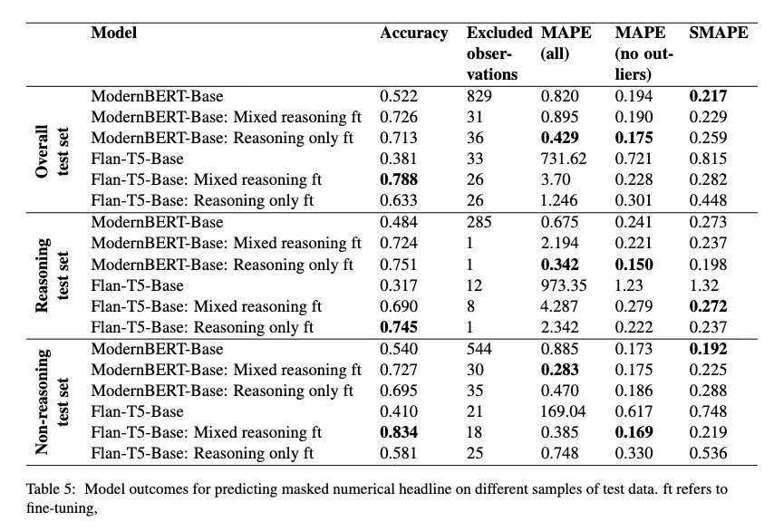

Slide 11
Limitations & Future Work
Small models (yet outperforms zero-shot approaches with large models)
Out-of-vocabulary labels
ModernBERT - only one token can be predicted
Future work
Multiple tokenization representations of labels
Could incorporate data augmentation or secondary data approaches

Slide 12
Questions?

Slide 13
THANK YOU

